Slide 1
Agenda
Introduction – Web Service
Web Service Features
SOAP and Restful Web Services
Benefits of RESTful Web Services
Practical Implementation with Spring JPA

Slide 2
What is Web Service
Web Services are client and server applications that communicate over the World Wide Web's (WWW) Hypertext Transfer Protocol (HTTP).
Web services implementation allows two web applications developed in different languages to interact with each other using a standardized medium like XML, SOAP, HTTP etc.

Slide 3
Features of Web Services
Web services are based on open standards like XML, HTTP. So these are operating system independent.
Likewise, web services are programming language independent. A Java application can consume a PHP web service.
Web services can be published over the internet to be consumed by other web applications.
The consumer or the client of the web-service is loosely coupled with the web service. So the web services can update or change its underlying logic without affecting the consumer.

Slide 4
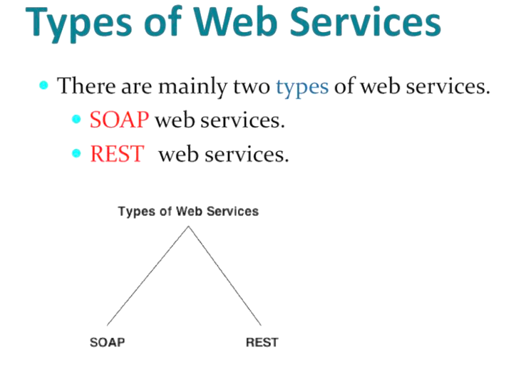

Slide 5
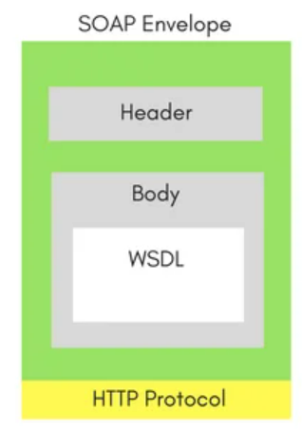
SOAP Web Services
SOAP stands for Simple Object Access Protocol.
SOAP provides an envelope to send a web services messages over the Internet, using the HTTP protocol. The messages are generally in XML format.
Well, every application serving SOAP requests, has a WSDL file.
WSDL is an XML, and it stands for Web Service Description Language. WSDL describes all the methods available in the web service, along with the request and response types. It describes the contract between service and client.

Slide 6
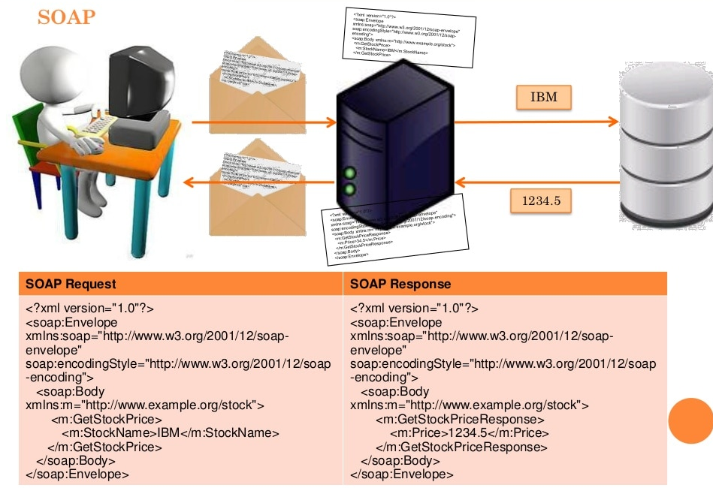

Slide 7
REST Web Services
The REST stands for Representational State Transfer.
REST is not a set of standards or rules, rather it is a style of software architecture. The applications which follow this architecture are referred to as RESTful
Unlike SOAP which targets the actions, REST concerns more on the resources.
REST locates the resources by using URL and it depends on the type of transport protocol(with HTTP - GET, POST, PUT, DELETE,...) for the actions to be performed on the resources.

Slide 8
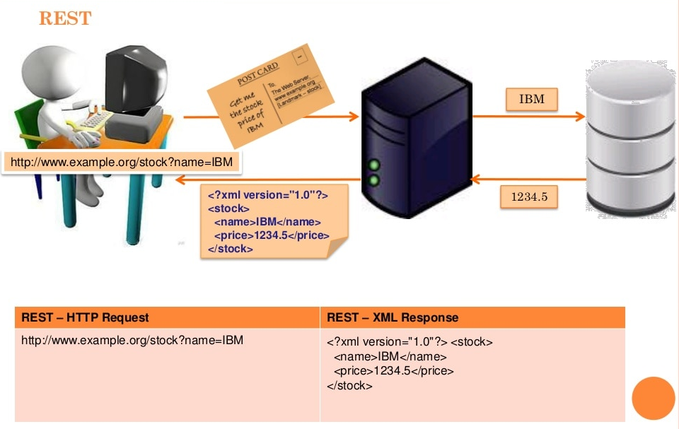

Slide 9
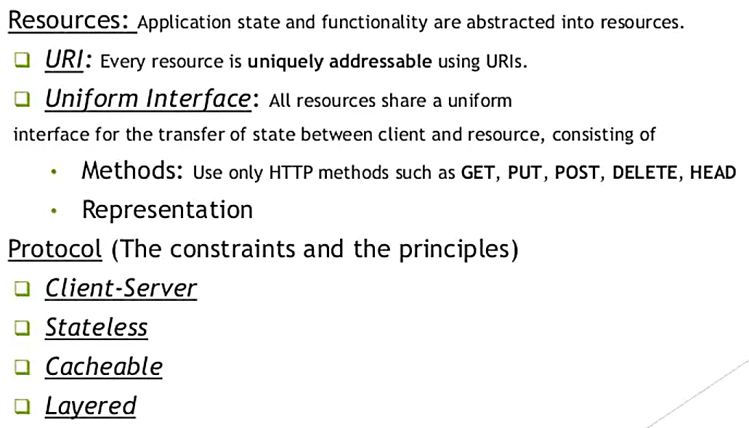
Characteristic of REST

Slide 10
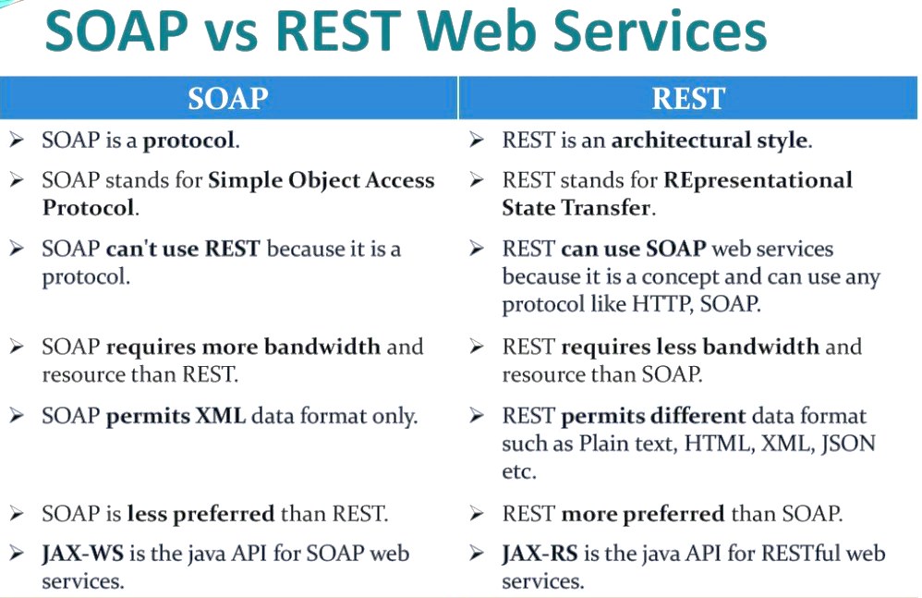

Slide 11
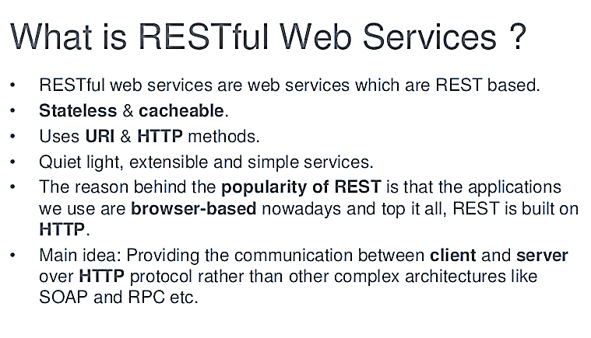

Slide 12
Several Benefits of RESTful Web Services
Platform independent.
Simple and easy to implement and test.
Support different formats such as JSON, XML, HTML, etc.
Can be written in different programming languages and executed on any platform.
Lightweight, manageable, scalable, and reusable.
Faster and provide better performance.
Consume less bandwidth and resources.
A lot of automation framework is available

Slide 13
Practical Demo CRUD With Spring Boot JPA
I will Show now how to Develop
A RESTful web services API for CRUD operations (Create, Retrieve, Update and Delete)
Corresponding to standard HTTP methods POST, GET, PUT and DELETE,
Using Spring Boot, Spring JPA, MySQL.

Slide 14
Software Prerequisite
Java Development Kit (JDK)
Eclipse IDE
Spring Tool Suite
MySQL
Postman program to test the webservices.

Slide 15
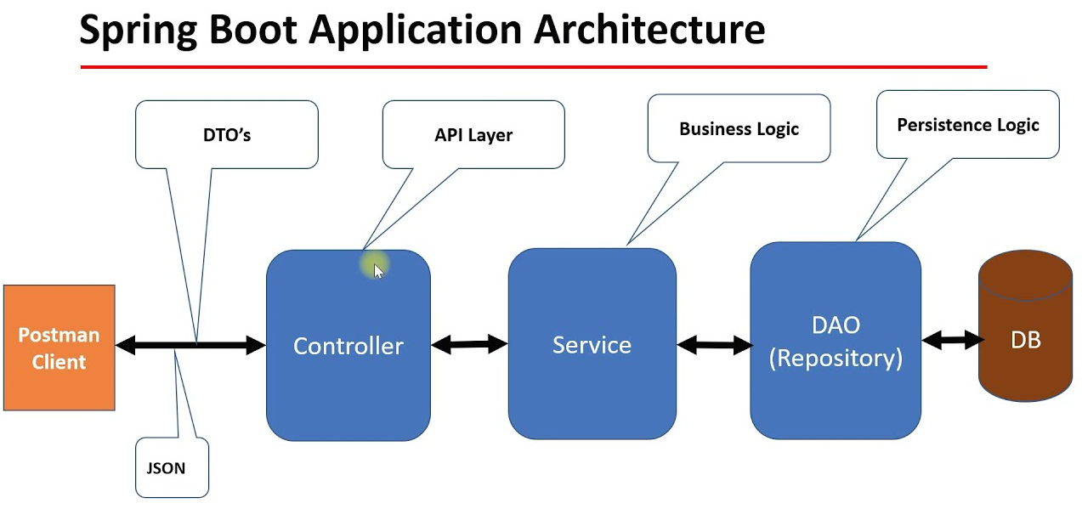
Practical Demo CRUD With Spring Boot JPA

Slide 16
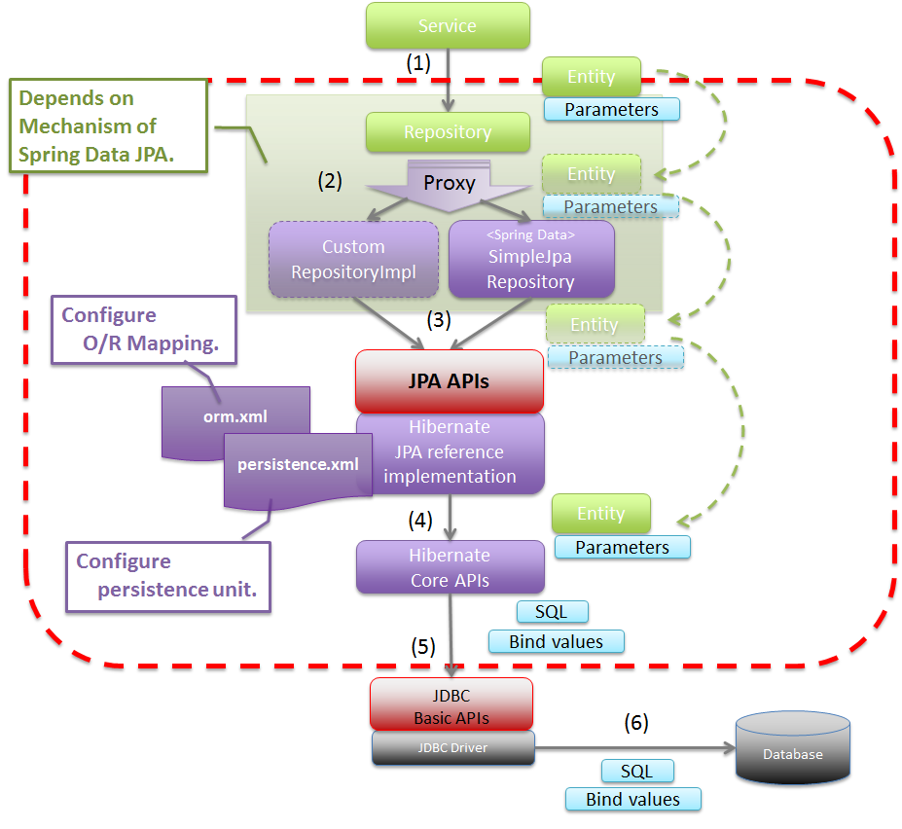
Application Architecture

Slide 17
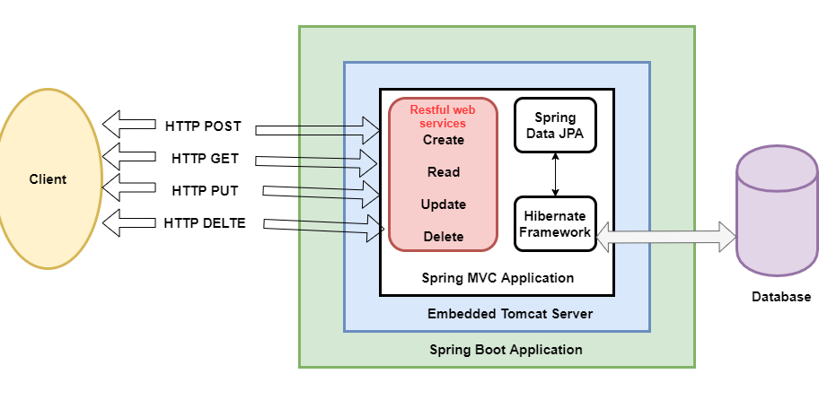
Application Functionality

Slide 18
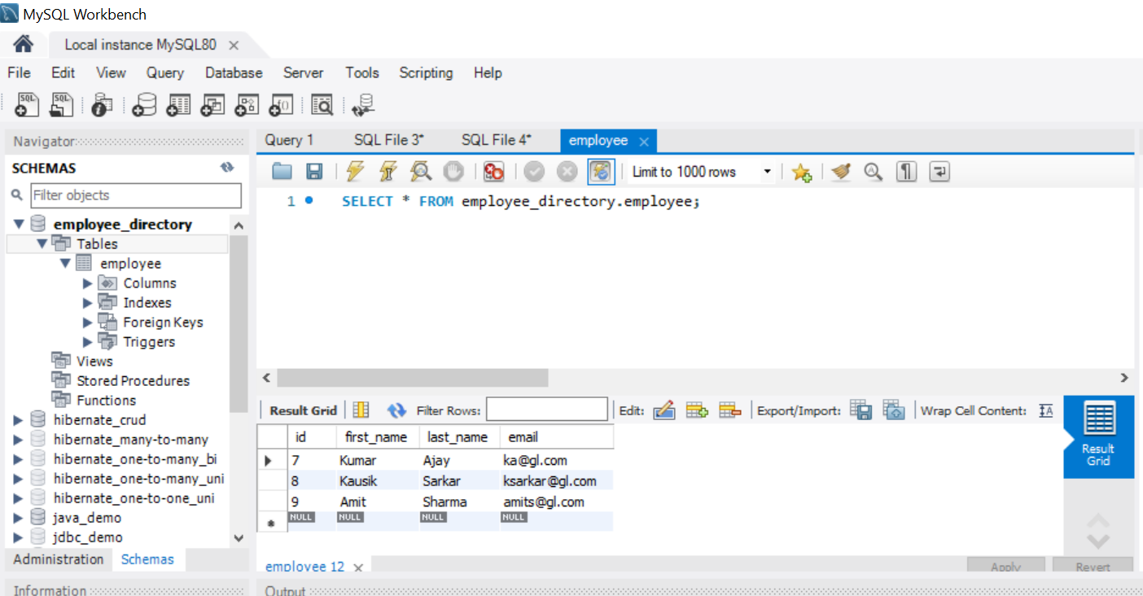
Application Entity

Slide 19
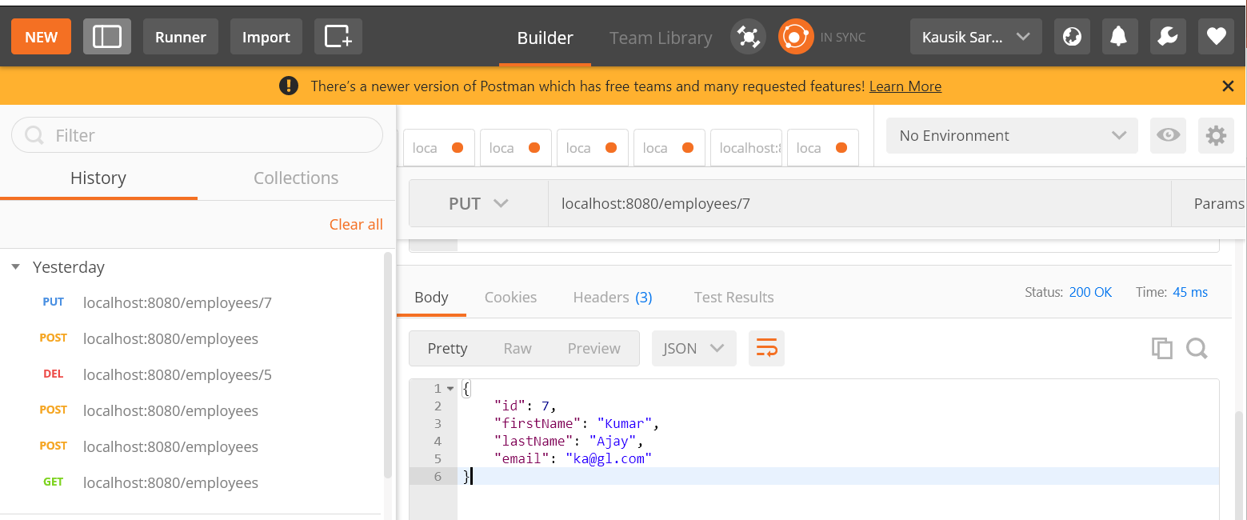
Application Testing – With Postman

Slide 20

Thank You
Proprietary content. ©Great Learning. All Rights Reserved. Unauthorized use or distribution prohibited

